Slide 1
Build a Bot Workshop: with Node.js
Katherine ‘Kat’ Harris
@katvharris

Slide 2
Download the Tools
Download Node.js
https://nodejs.org/en/
Download an IDE (i.e. Visual Studio Code)
https://code.visualstudio.com/
Download the Microsoft Emulator
https://docs.botframework.com/en-us/tools/bot-framework-emulator/

Slide 3


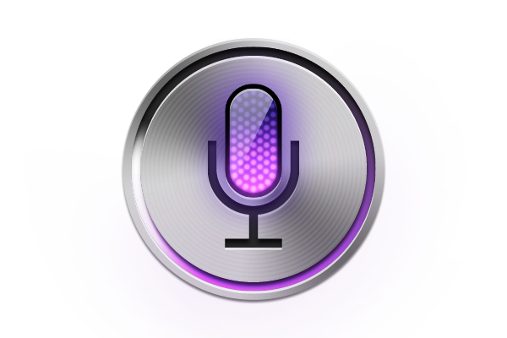

What are Bots?

Slide 4
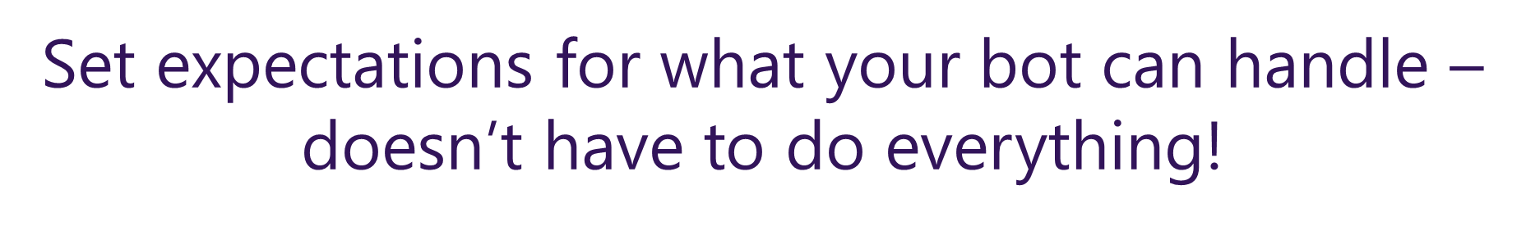
Bots are Apps Conversation as a Platform (CaaP)
Information Focused
Knowledge base
Question and answer
Action Focused
Task automation
Bot to human handoff

Slide 5
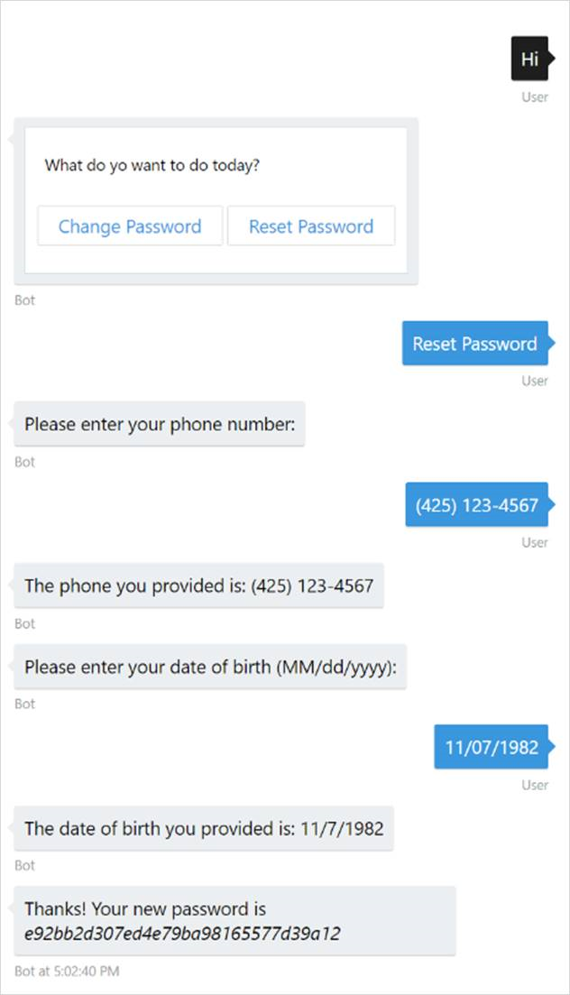
Task Automation
Not all bots need to have a conversation to be useful
Remember, bots are just apps!

Slide 6
Knowledge Base
Use Azure Search (or some other search engine) to get the most out of your data source
Facet and filter the dataset until we find what the user wants
Fuzzy search for non-exact matches
Search scores will give a confidence of how sure we are the data we found is what the user asked for

Slide 7
Questions and Answers
Unreasonable to code for every possible question and answer pair
QnaMaker.ai is a low friction way to create a bot

Slide 8
Bot to Human Handoff
Triage
Gather necessary info from the user to save a human time
Supervision
The bot gathers information and makes a decision, but waits for a human to verify before proceeding
Escalation
Know when your bot can‘t handle the situation anymore
Don‘t wait for your user to become frustrated to escalate to a human

Slide 9
Microsoft Bot Framework

Slide 10
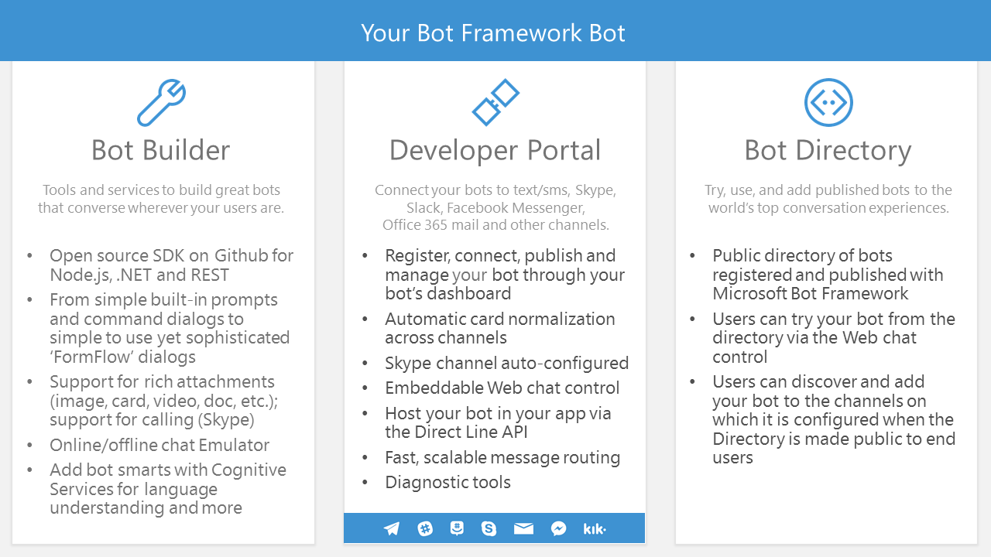

Slide 11
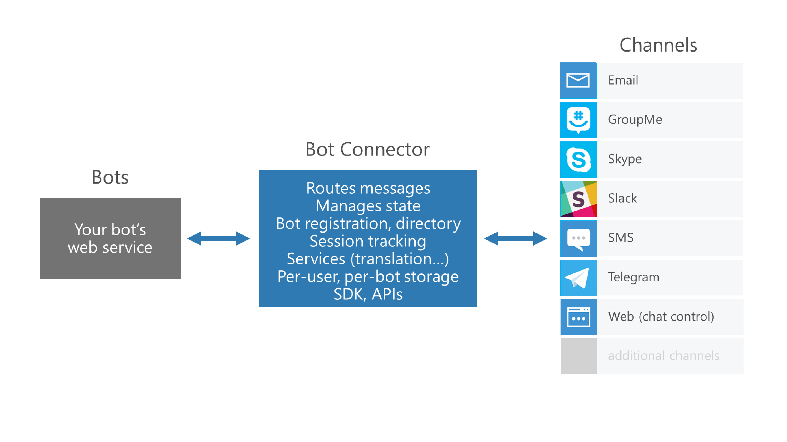
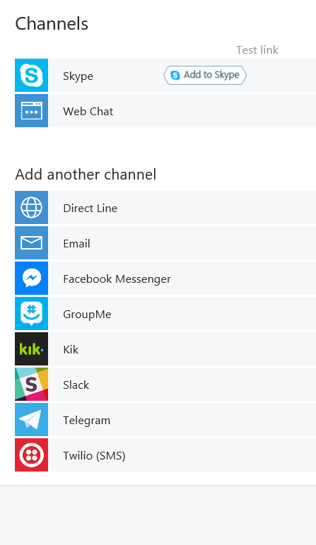

Slide 12
Designing Bots

Slide 13
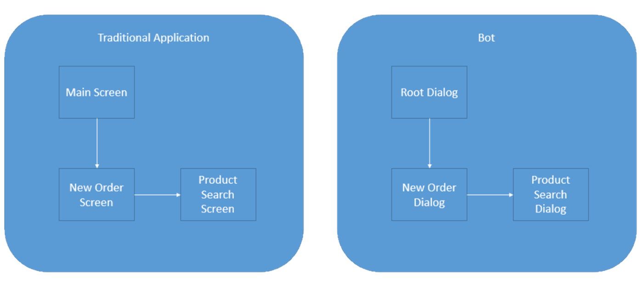
Bot design is app design
Screens become dialogs organized into a “stack”

Slide 14
Navigating the dialog stack
Begin Dialog
Add a new dialog to the top of stack
Replace Dialog
Remove the top dialog from the stack & replace it with a different one
Cancel Dialog
Cancel the first occurrence of a specific dialog in the stack
End Dialog
End the current dialog and return to the next one on the stack

Slide 15
Making our bot w/ Node.js

Slide 16
Download the Tools
Download Node.js
https://nodejs.org/en/
Download an IDE (i.e. Visual Studio Code)
https://code.visualstudio.com/
Download the Microsoft Emulator
https://docs.botframework.com/en-us/tools/bot-framework-emulator/

Slide 17
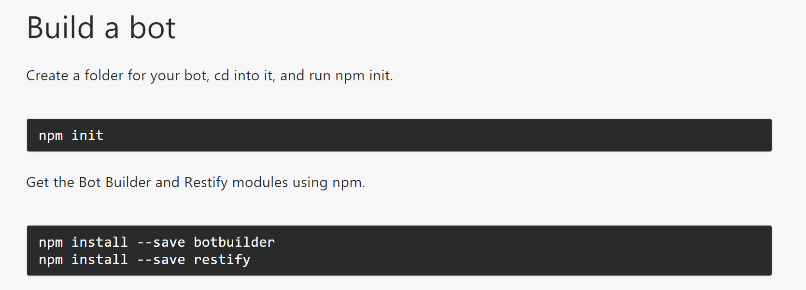
Import the appropriate Libraries
Notes:
Npm init -y

Slide 18
Write some code… hello world
Open the folder you created with your IDE
Create app.js file in the folder you created

Slide 19
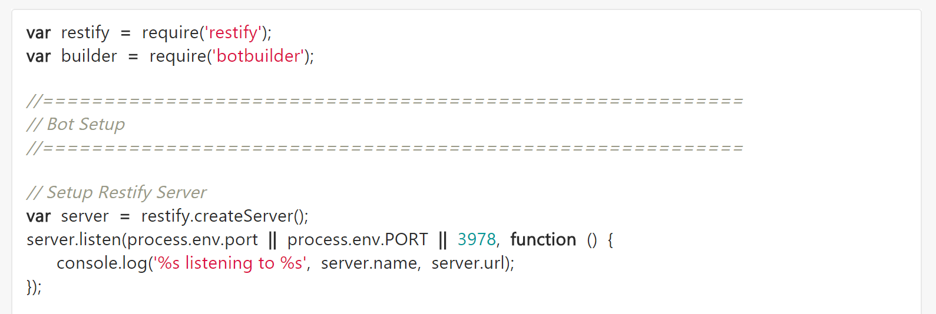
Code Snippet (1)
Notes:
var restify = require('restify'); var builder = require('botbuilder'); //========================================================= // Bot Setup //========================================================= // Setup Restify Server var server = restify.createServer(); server.listen(process.env.port || process.env.PORT || 3978, function () { console.log('%s listening to %s', server.name, server.url); }); // Create chat bot var connector = new builder.ChatConnector({ appId: process.env.MICROSOFT_APP_ID, appPassword: process.env.MICROSOFT_APP_PASSWORD }); var bot = new builder.UniversalBot(connector); server.post('/api/messages', connector.listen()); //========================================================= // Bots Dialogs //========================================================= bot.dialog('/', function (session) { session.send("Hello World"); });

Slide 20
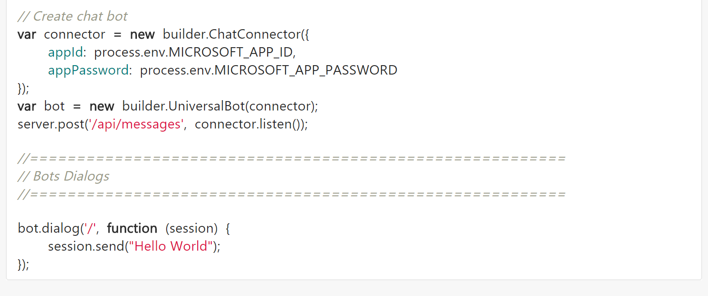
Code Snippet (2)
Notes:
var restify = require('restify'); var builder = require('botbuilder'); //========================================================= // Bot Setup //========================================================= // Setup Restify Server var server = restify.createServer(); server.listen(process.env.port || process.env.PORT || 3978, function () { console.log('%s listening to %s', server.name, server.url); }); // Create chat bot var connector = new builder.ChatConnector({ appId: process.env.MICROSOFT_APP_ID, appPassword: process.env.MICROSOFT_APP_PASSWORD }); var bot = new builder.UniversalBot(connector); server.post('/api/messages', connector.listen()); //========================================================= // Bots Dialogs //========================================================= bot.dialog('/', function (session) { session.send("Hello World"); });

Slide 21
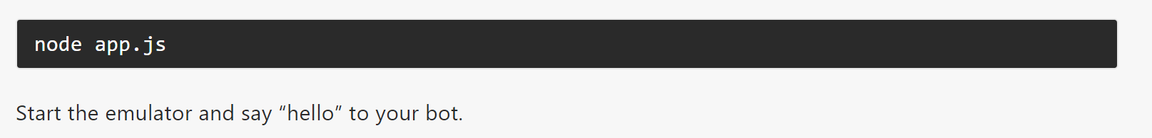
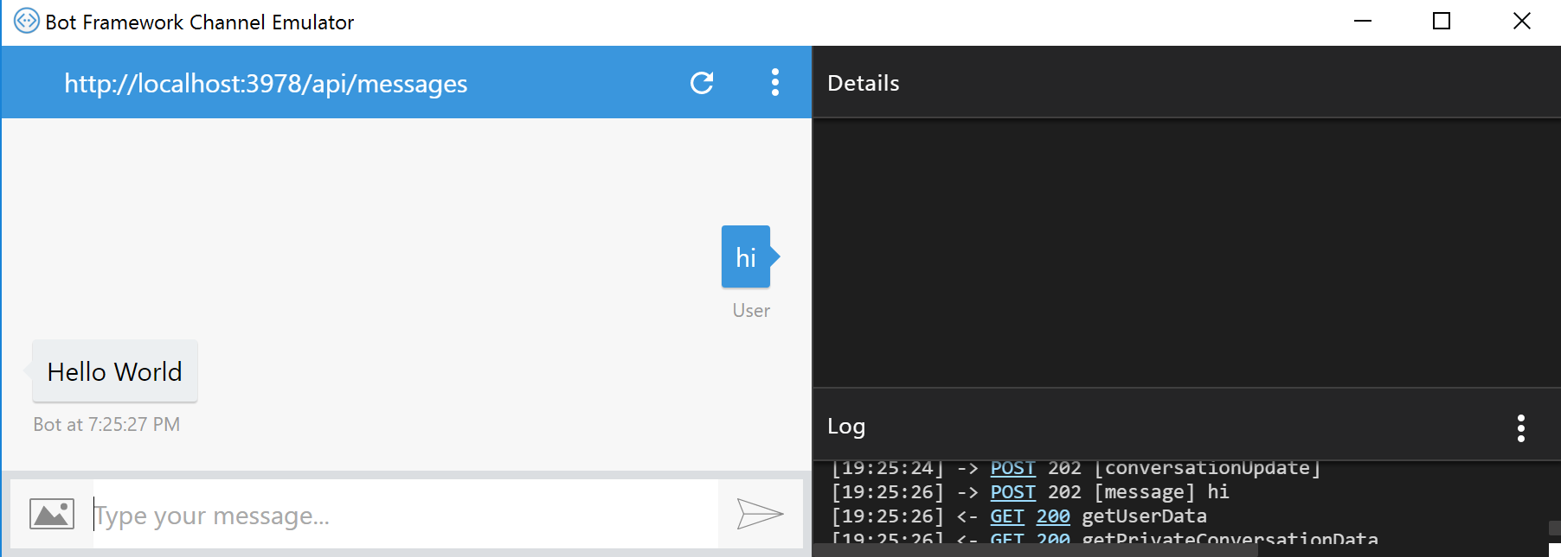
Test your code

Slide 22
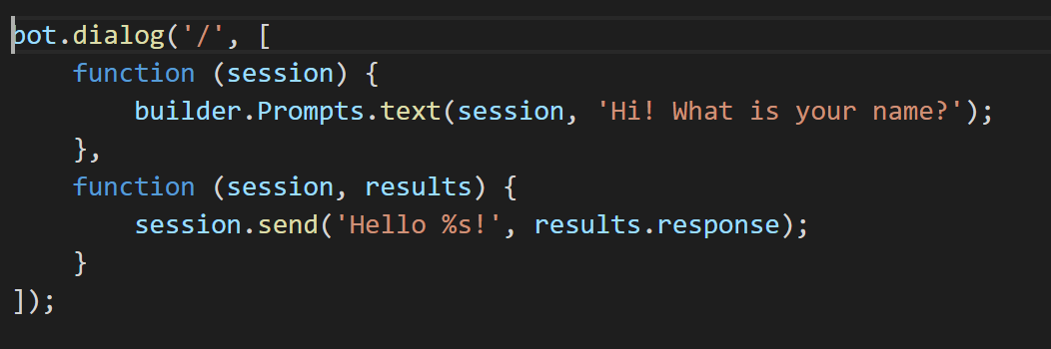
Waterfall
Notes:
bot.dialog('/', [
function (session) {
builder.Prompts.text(session, 'Hi! What is your name?');
},
function (session, results) {
session.send('Hello %s!', results.response);
}
]);

Slide 23
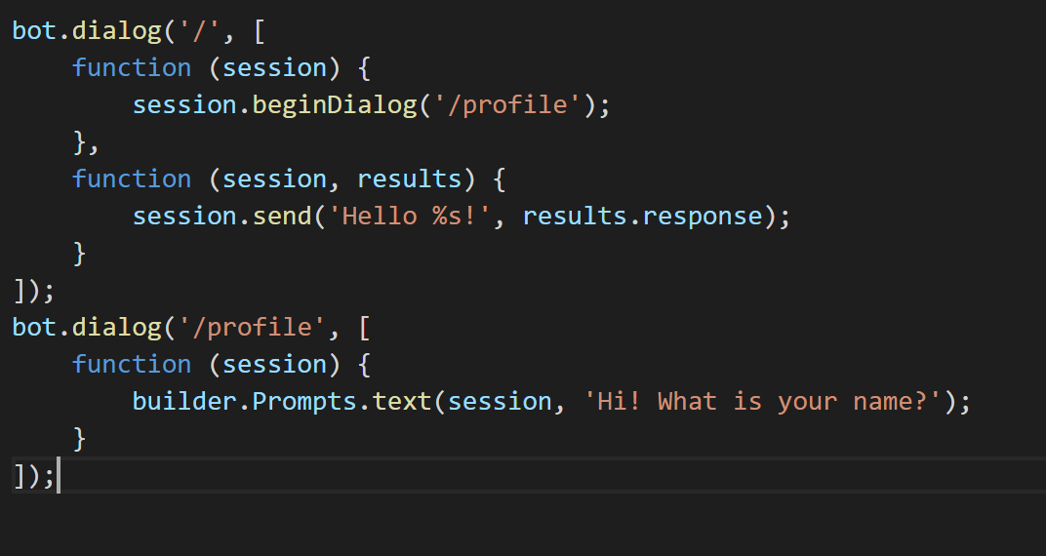
Creating other Dialogs
Notes:
bot.dialog('/', [
function (session) {
session.beginDialog('/profile');
},
function (session, results) {
session.send('Hello %s!', results.response);
}
]);
bot.dialog('/profile', [
function (session) {
builder.Prompts.text(session, 'Hi! What is your name?');
}
]);

Slide 24
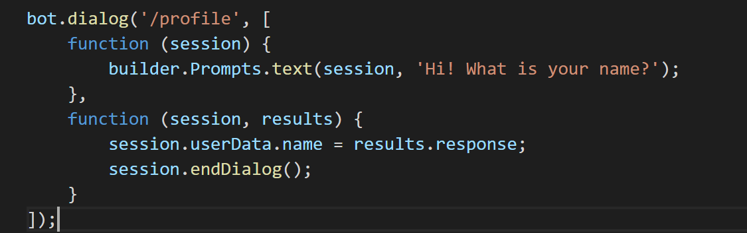
Saving User Data (1)
- Add another function to the /profile dialog
Notes:
bot.dialog('/profile', [
function (session) {
builder.Prompts.text(session, 'Hi! What is your name?');
},
function (session, results) {
session.userData.name = results.response;
session.endDialog();
}
]);

Slide 25
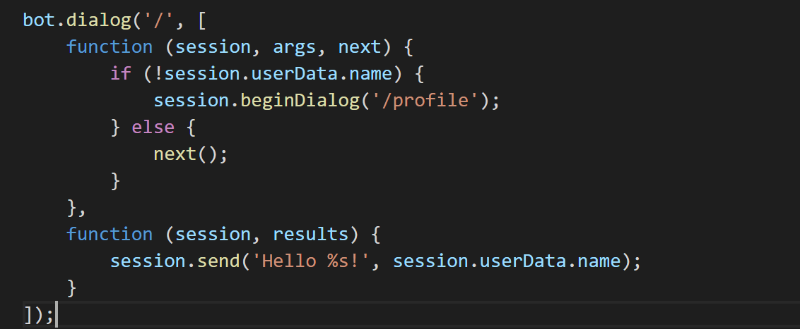
Saving User Data (2)
Add conditional to initial root dialog
Change results.response to userData.name in the 2nd function of the Root
Notes:
We want to now test to see if the session user data saved the user’s name
If it did not spin up the profile dialog
If it does then go to the next step in the Waterfall… aka Hello (user’s name).
bot.dialog('/', [
function (session, args, next) {
if (!session.userData.name) {
session.beginDialog('/profile');
} else {
next();
}
},
function (session, results) {
session.send('Hello %s!', session.userData.name);
}
]);

Slide 26
Understanding User’s Intent
Create an intents variable
Change the root dialog to accept intents
Move code from root dialog into Default intent
Add new intent code

Slide 27
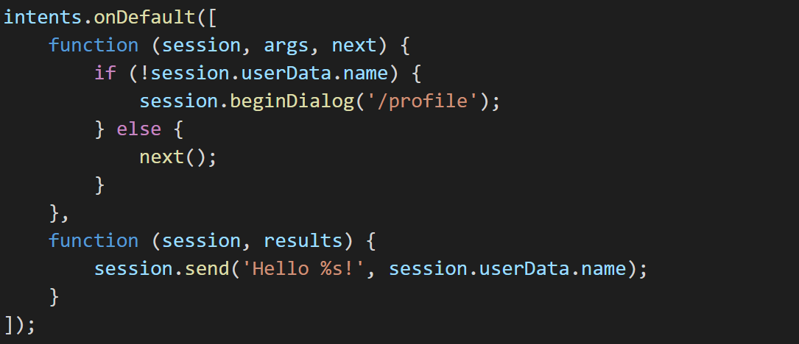
Move Code
Notes:
intents.onDefault([
function (session, args, next) {
if (!session.userData.name) {
session.beginDialog('/profile');
} else {
next();
}
},
function (session, results) {
session.send('Hello %s!', session.userData.name);
}
]);

Slide 28
Add intents variable and change Root
Notes:
var intents = new builder.IntentDialog();
bot.dialog('/', intents);

Slide 29
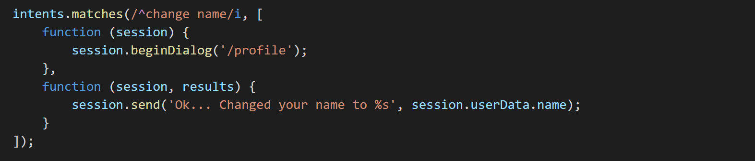
Add new intent – Change Name
- Add code before /profile function
Notes:
intents.matches(/^change name/i, [
function (session) {
session.beginDialog('/profile');
},
function (session, results) {
session.send('Ok... Changed your name to %s', session.userData.name);
}
]);

Slide 30
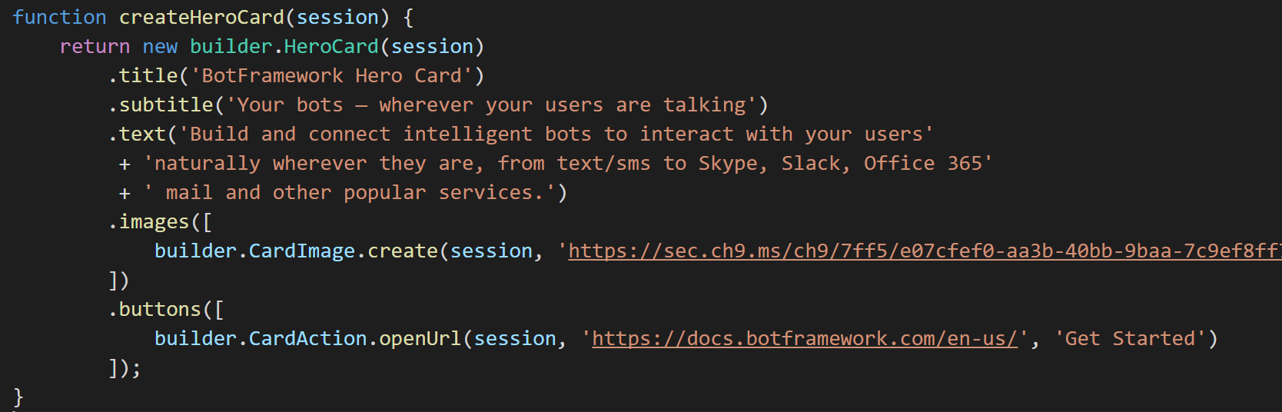
Add Hero Card Function
- Get image from the web
Notes:
function createHeroCard(session) {
return new builder.HeroCard(session)
.title('BotFramework Hero Card')
.subtitle('Your bots — wherever your users are talking')
.text('Build and connect intelligent bots to interact with your users naturally wherever they are, from text/sms to Skype, Slack, Office 365 mail and other popular services.')
.images([
builder.CardImage.create(session, 'https://sec.ch9.ms/ch9/7ff5/e07cfef0-aa3b-40bb-9baa-7c9ef8ff7ff5/buildreactionbotframework_960.jpg')
])
.buttons([
builder.CardAction.openUrl(session, 'https://docs.botframework.com/en-us/', 'Get Started')
]);
}

Slide 31
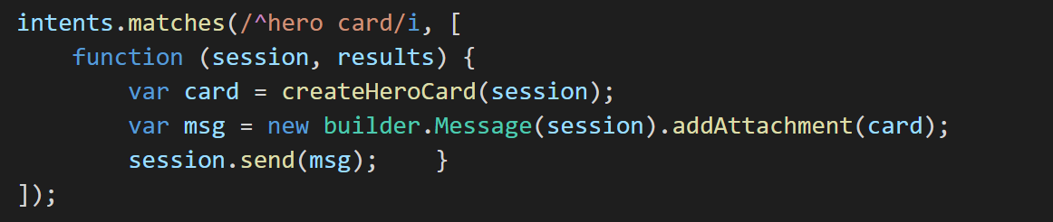
Add ‘hero card’ intent
Notes:
intents.matches(/^hero card/i, [
function (session, results) {
var card = createHeroCard(session);
var msg = new builder.Message(session).addAttachment(card);
session.send(msg); }
]);

Slide 32
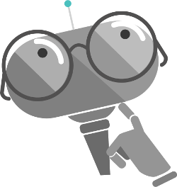
Making your bot Smart

Slide 33
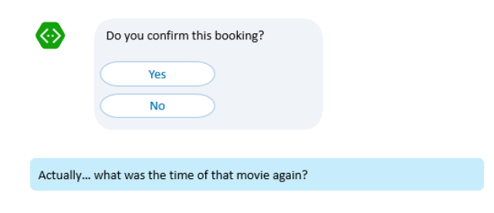
Users don’t think in Dialog stacks...
…so now what?

Slide 34
What makes a bot seem smart?
Natural Language Processing (NLP)
Analyze the intents and entities in each user utterance

Slide 35
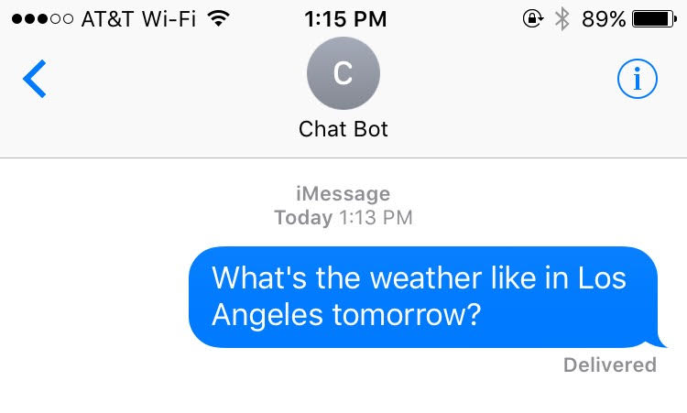
Intents, entities, and utterances
public void getWeather(string loc, DateTime date)
{
// Do Something
}

Slide 36
Language Understanding Intelligent Service (LUIS.ai)
Lets you understand what your users are saying
A few examples are enough to deploy an application
LUIS learns over time
Define
Concepts
Provide
Examples
Active Learning
Deploy

Slide 37
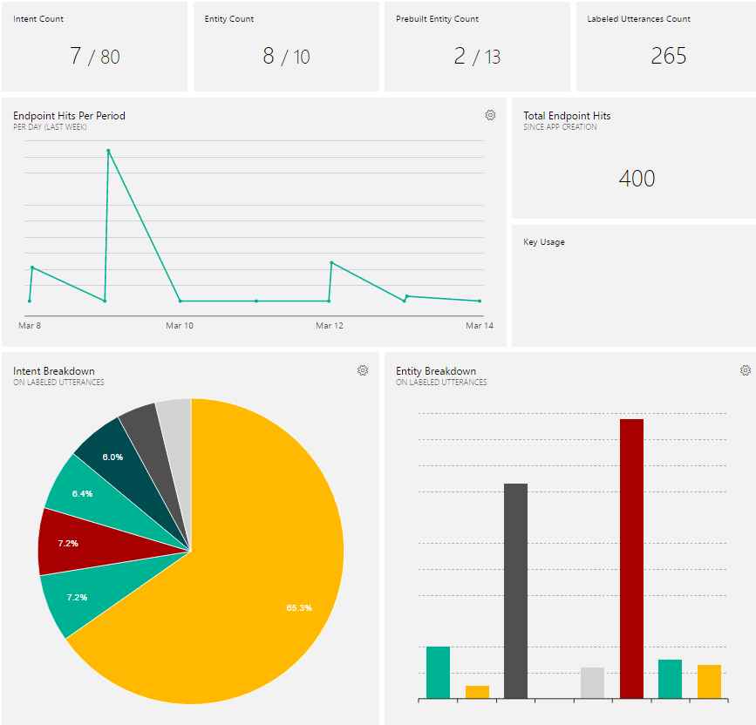

Slide 38
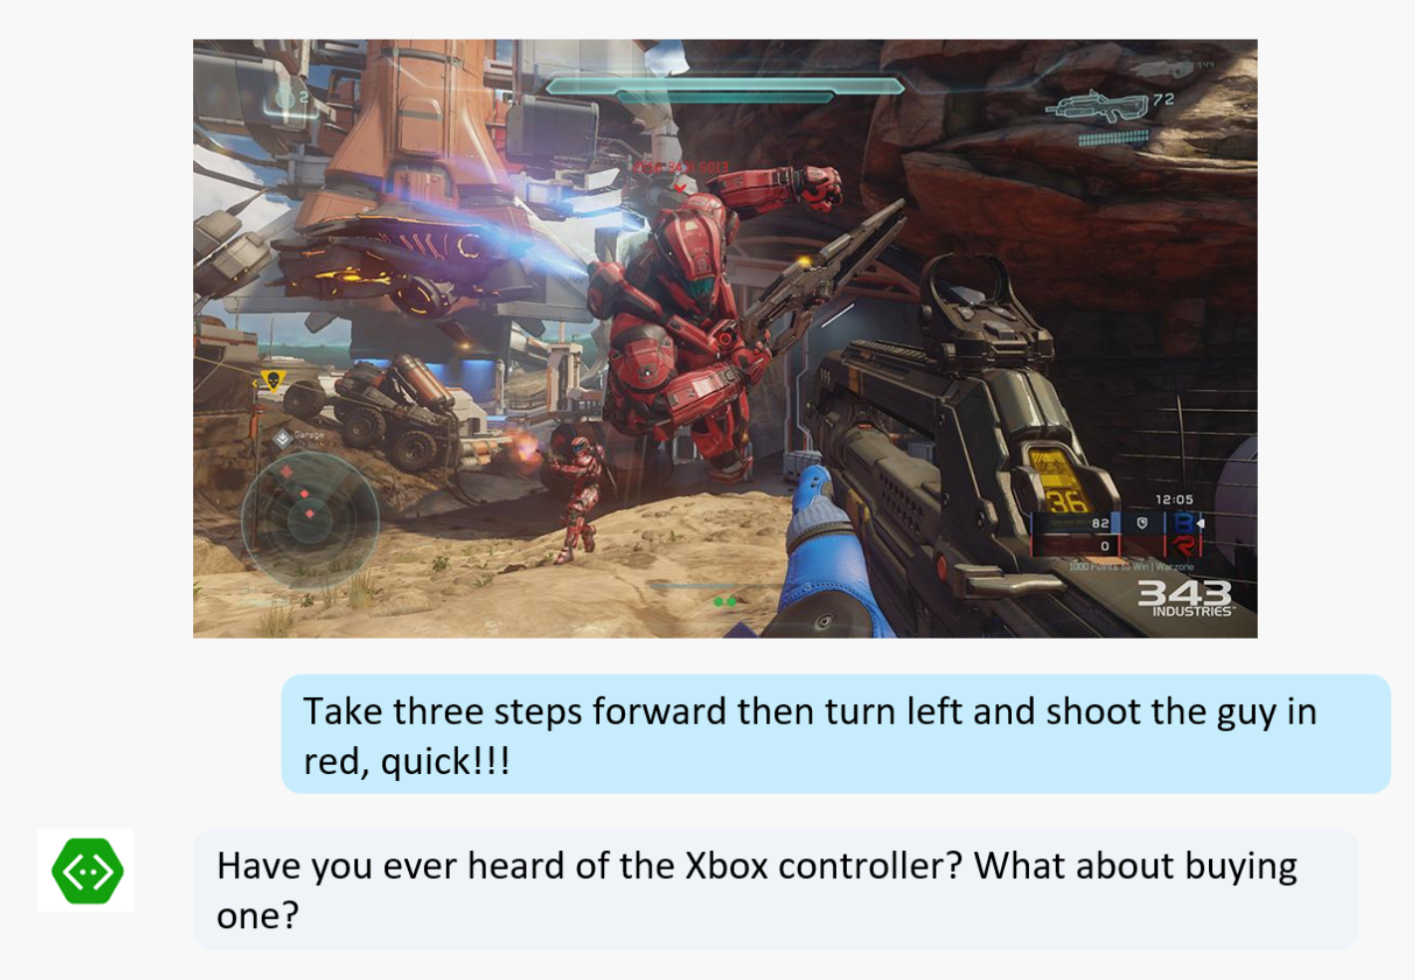
What makes a bot seem smart?
Natural Language Processing

Slide 39
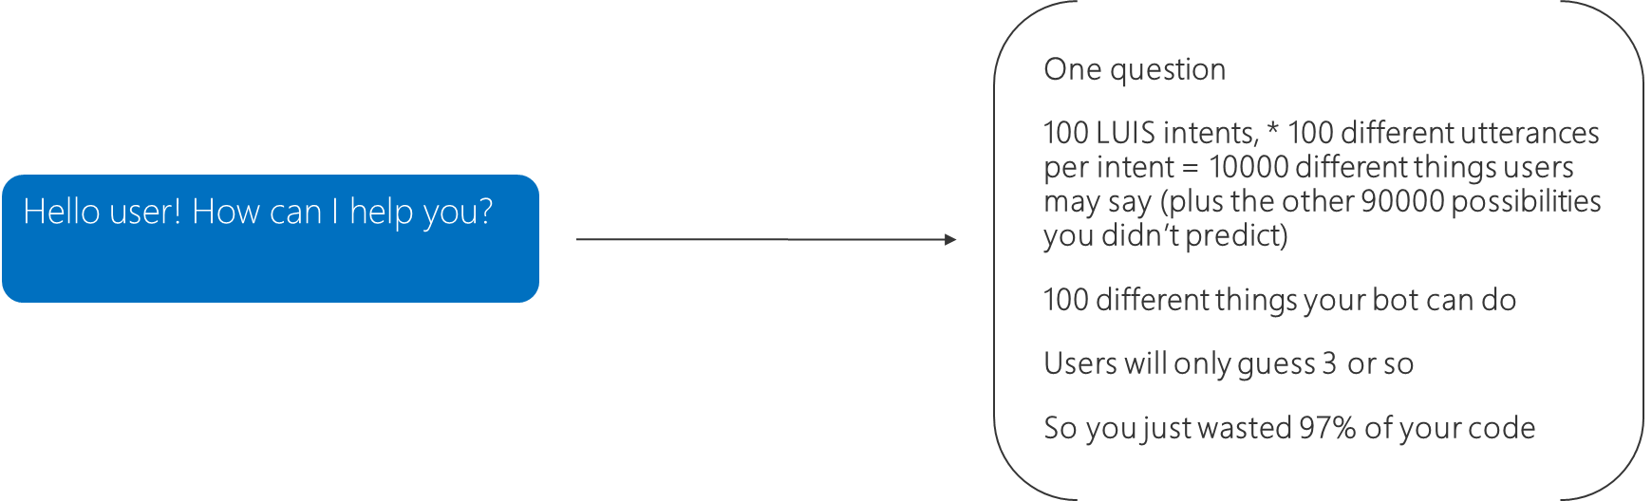
What makes a bot seem smart?
Natural Language Processing

Slide 40
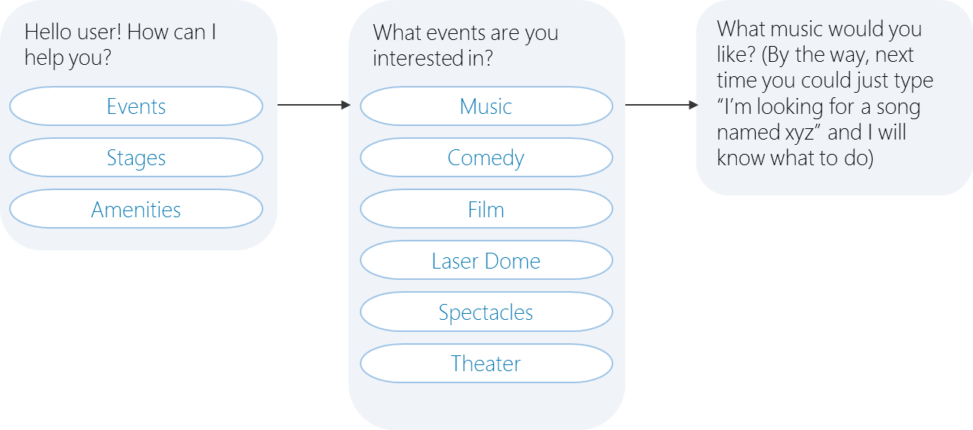
What makes a bot seem smart?
Natural Language Processing
Instead, help the user discover what your bot can do

Slide 41
QnA Maker
https://qnamaker.ai/
npm install --save botbuilder-cognitiveservices

Slide 42
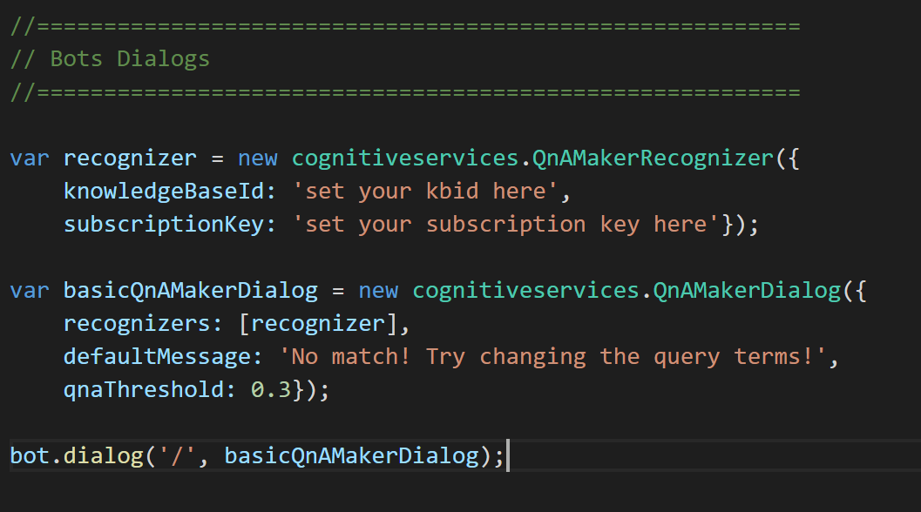
Adding QnA code
- var cognitiveservices = require('../lib/botbuilder-cognitiveservices');
Notes:
var cognitiveservices = require('botbuilder-cognitiveservices');
var recognizer = new cognitiveservices.QnAMakerRecognizer({
knowledgeBaseId: '67e04557-1c27-4045-b1c1-8469aab5e53c',
subscriptionKey: 'fe6e8e5c4d364d4ebb55428ec4030b48'});
var basicQnAMakerDialog = new cognitiveservices.QnAMakerDialog({
recognizers: [recognizer],
defaultMessage: 'No match! Try changing the query terms!',
qnaThreshold: 0.3});

Slide 43
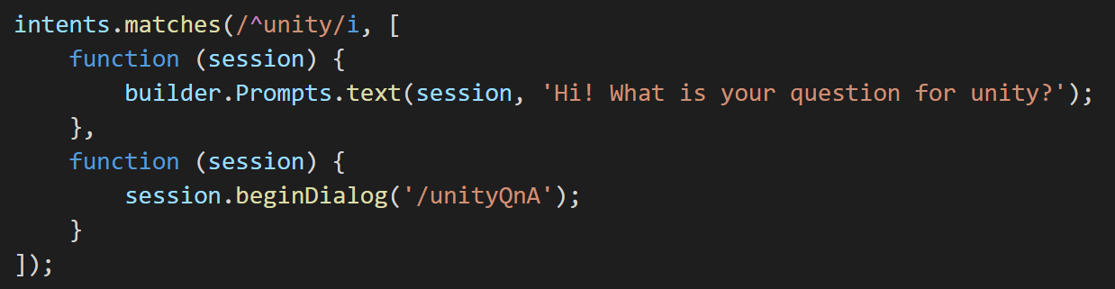
Create a new intent and Dialog to call
Notes:
intents.matches(/^unity/i, [
function (session) {
builder.Prompts.text(session, 'Hi! What is your question for unity?');
},
function (session) {
session.beginDialog('/unityQnA');
}
]);

Slide 44
So what really makes a bot seem smart?

Slide 45
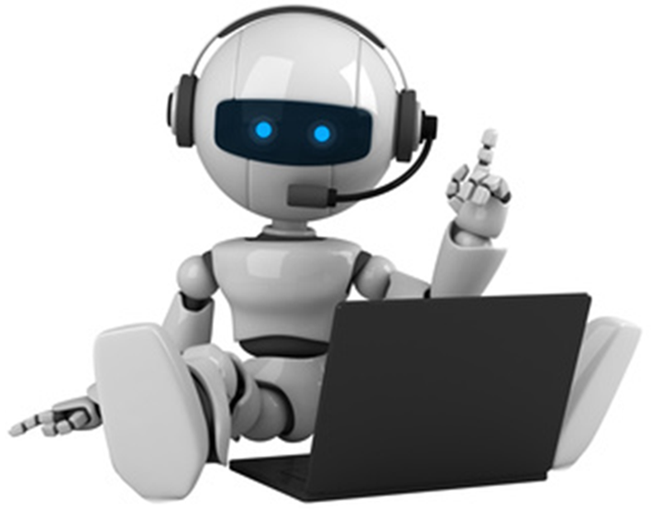
User experience
Solve the user’s problems better than the alternative
More natural interface for apps and websites
Available on multiple platforms
Meet the user where they already are (Slack, SMS, FB Messenger)
vs.
Downloading something new

Slide 46

Kaharri@Microsoft.com
@KatVHarris
http://github.com/katvharris

